Slide 1


Slide 2

Name: Mohammad Usman
Occupation: student

Slide 3
Content
Requirement
View
Structure
Documents

Slide 4
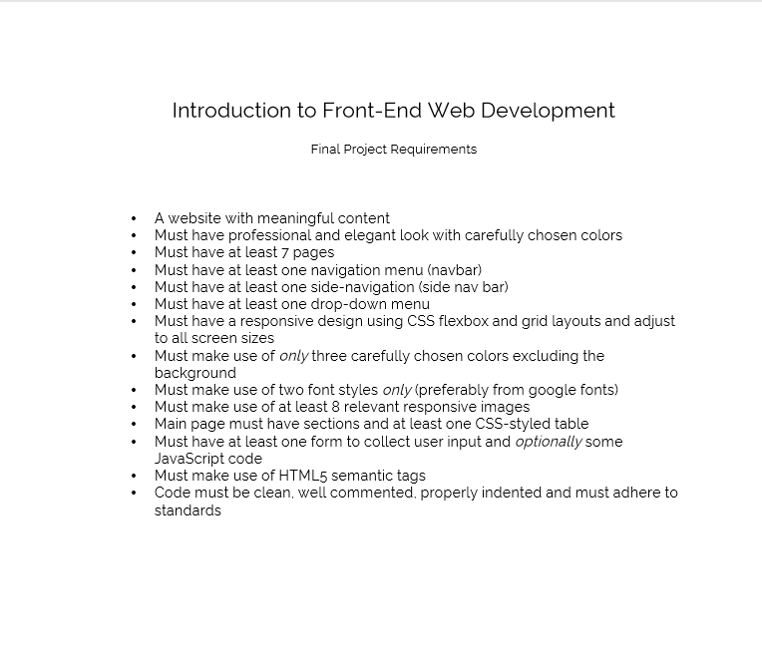

Slide 5
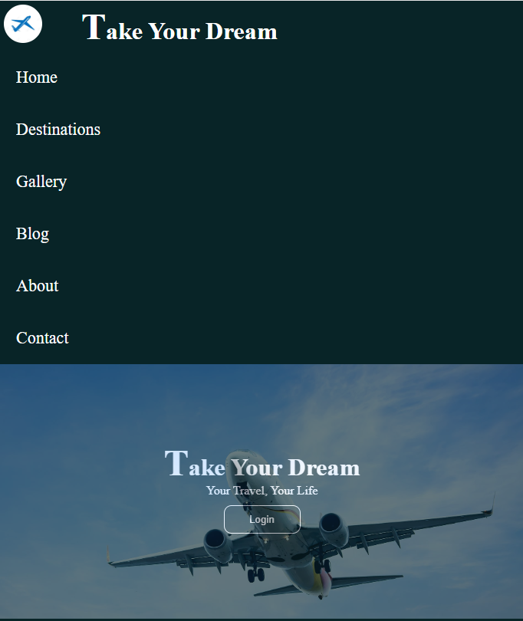
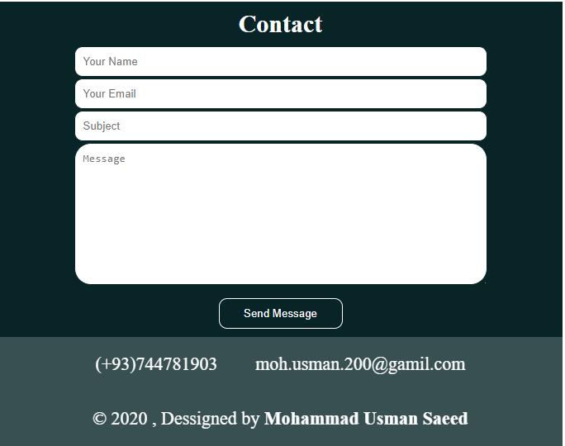

Slide 6
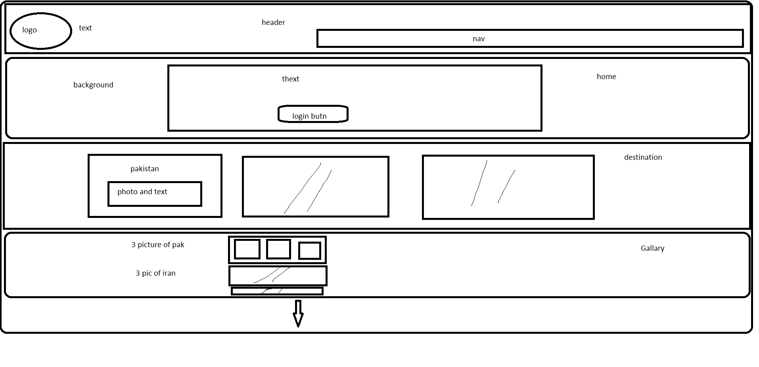

Slide 7
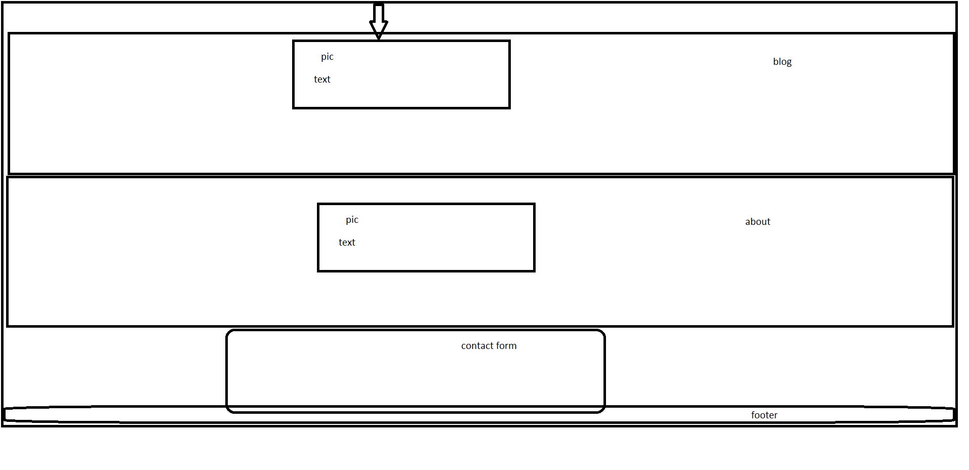

Slide 8
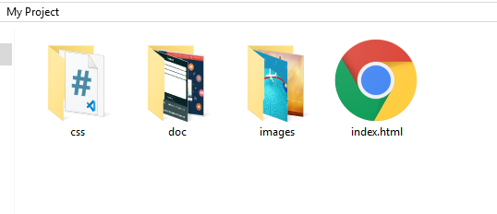

Slide 9
Thank You

